Slide 1
Analyzing Sicily’s Movement Relative to Eurasian Plate
Q1/Month
Year
GEOL 4002 - Jordyn Fulton - Spring 2026

Slide 2
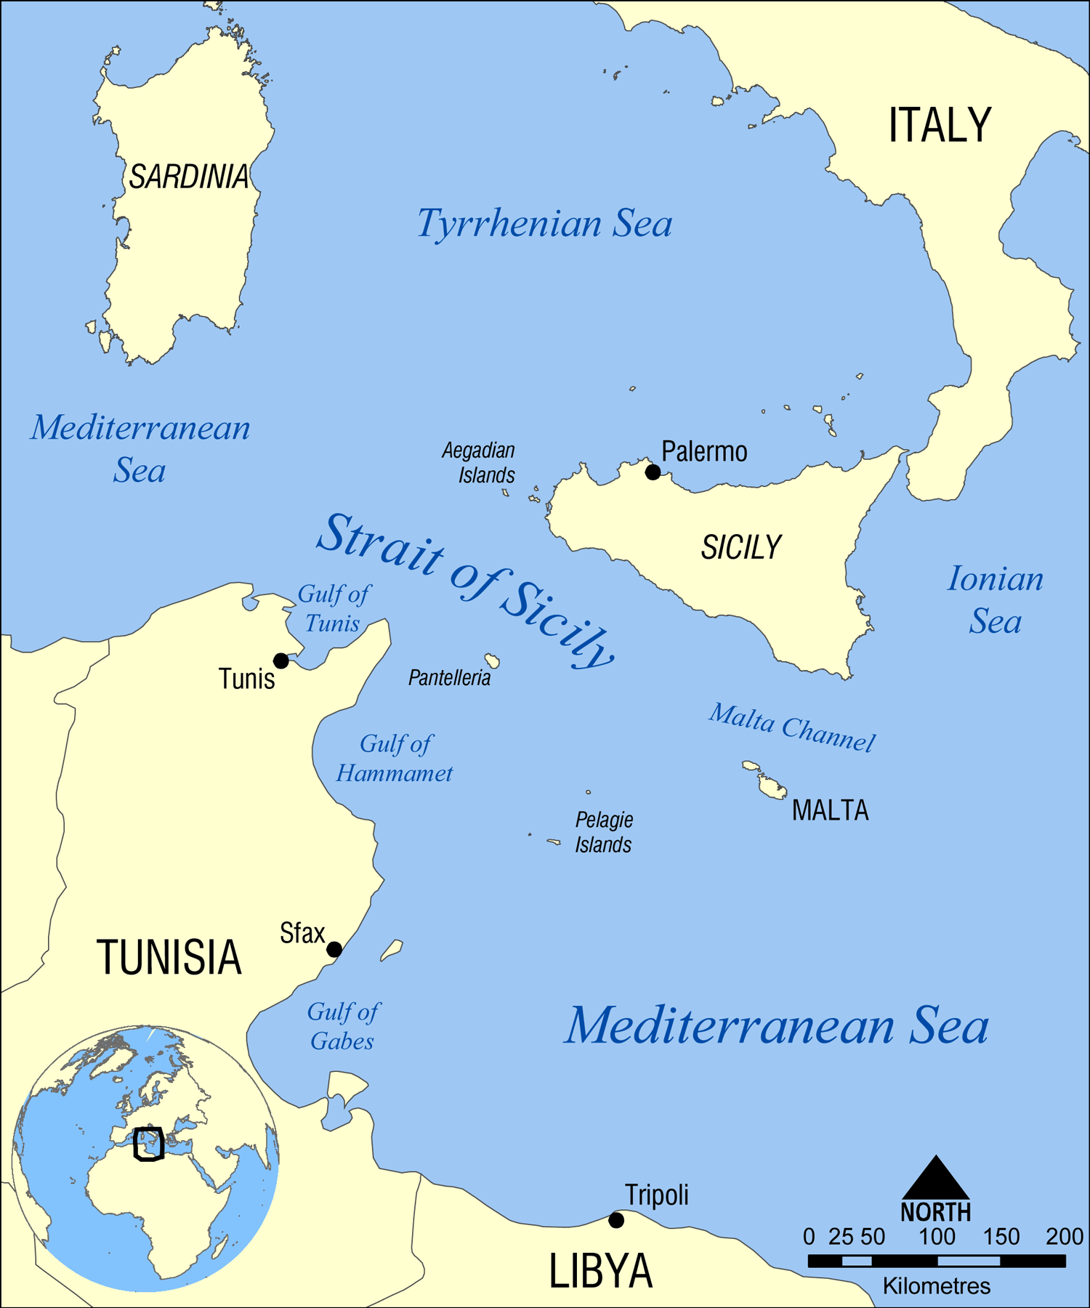
Project Overview
Add a short headline about your growth
The goal of this project was to plot Sicily’s direction of motion over the course of six years to see how the African plate is interacting with the Eurasian in this region.
Because of Sicily’s location in between a converging plate boundary, I expected the data to show a general movement in the north-west direction.
I chose to analyze the change in positions of nine stations along the perimeter of Sicily from 2010 to 2026 to calculate the velocity.

Slide 3
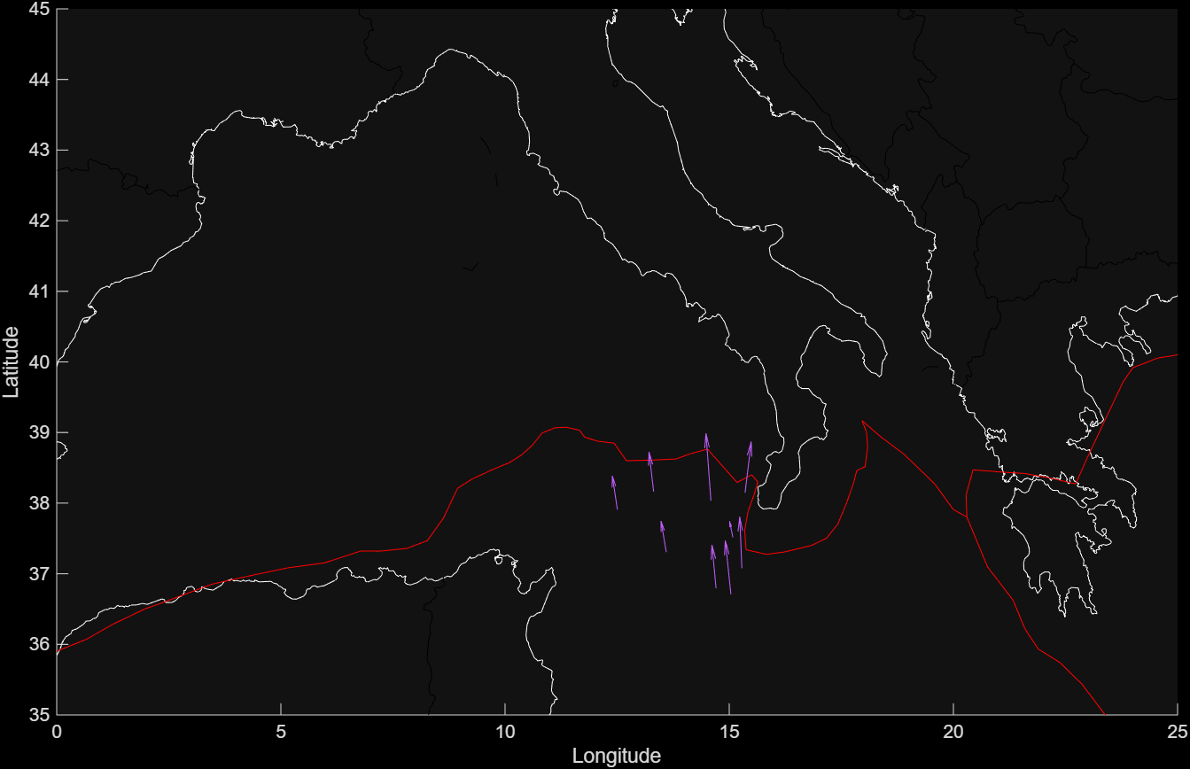
Map of Stations Displacement Velocity

Slide 4
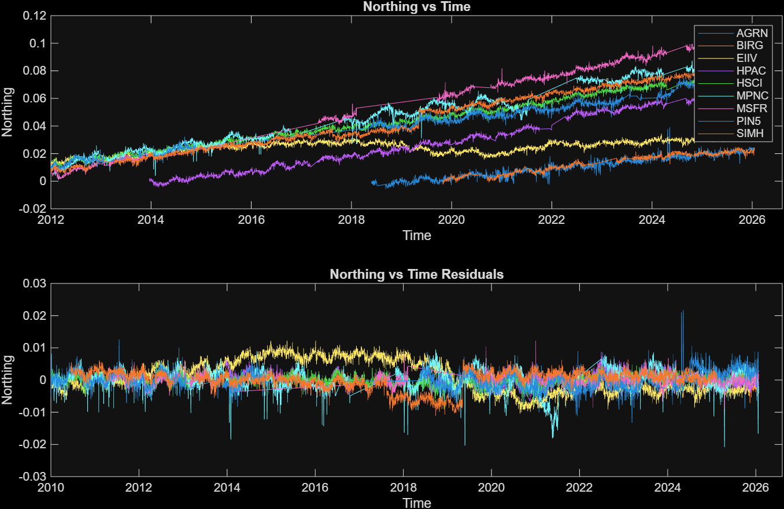
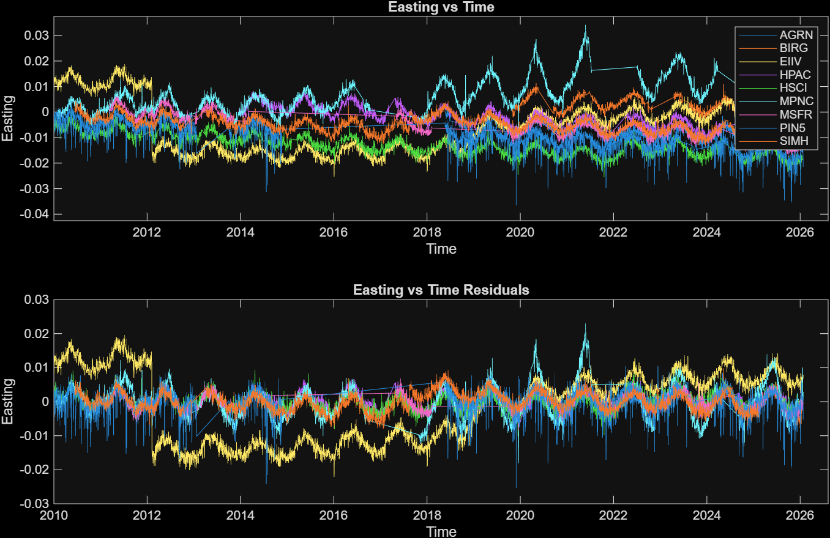
The change in northing and eastings over time provide a cumulative graphical view of the islands’ movement.
From these graphs, Sicily’s direction of movement can be described as moving north while experiencing frequent episodic tremors.

Slide 5
Thank you!

